Slide 1
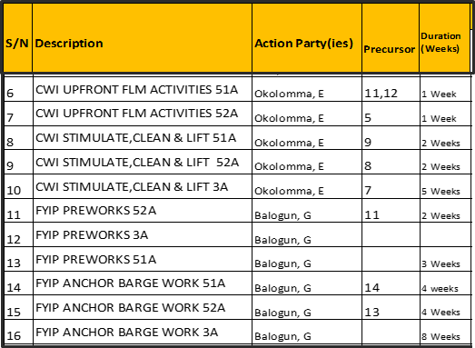
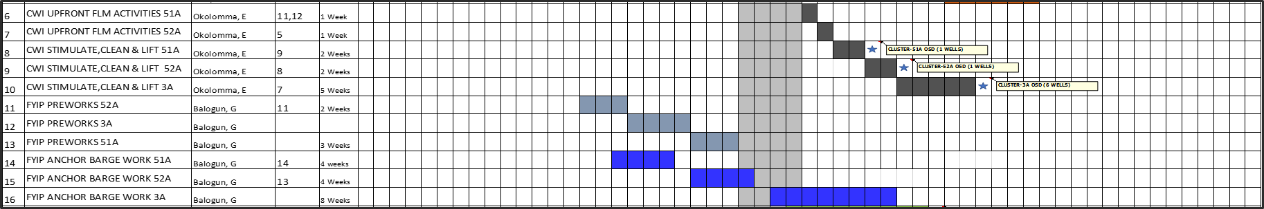
Project Title: Hook up and commission 12 FYIP Wells (17 Conduits) by April 2019
Business Case/Objectives:
Twelve (12) wells, seventeen (17) conduits currently locked-in awaiting hook-up in Forcados. These wells were drilled and completed as part of FYIP step 1A between 2001 and 2005. The updated well clean-up proposal was signed-off in June 2018 and ready for execution. However, there have been delays from the Project to complete hook-up of these wells. A barge was secured in April 2018, kitted up and about to sail to location for the riser installation and cluster works. There have been to many slips in schedule due to contractor inefficiencies. An E2E integration between Development, Production operations, CWI and the Project team is therefore required to drive the delivery and unlock 20304 bopd and develop 77.37 MMstb.
Potential Benefits & Measurement:
Cost savings: Avoidance of continuous standby cost due to contractors negligence and delays.
Cost benefit: Bring in 17 conduits to production wit a combined potential of 20304 bopd @oil price of 70 USD/bbl = USD1421280/day
Annual: USD 0.5 Bln
Critical Success Factors:
Weekly cadence
Competent contractors.
Deliver on schedule
Produce wells as expected.
L0-L1: 12th Dec ‘18
L2: 20th Dec ‘18
L3: 15th Jan ‘19
L4: 30th April ‘19
L5: 31st Dec ‘20
Project Sponsor: Maichibi Mesh.
Implementation/Project Lead: Elias Arochukwu

